Slide 1




Data Representation
CSCI 1101 Introduction to Computer Science

Slide 2
Overview
Definitions
Data
Data Representation
Number Systems
Binary
Decimal
Hexadecimal
Conversions
From Decimal
From Binary
From Hexadecimal
Computers & Data
Representing Text
Representing Images
Representing Sound
Representing Video
Representing Numbers

Slide 3

Definitions

Slide 4

What is Data?
Think back to projects, experiments, and other previous experiences.
Definition:
Characteristics or attributes that represent people, events, things, and ideas
Thus, data can be a:
Name
Number (measurement)
Color
Etc.

Slide 5
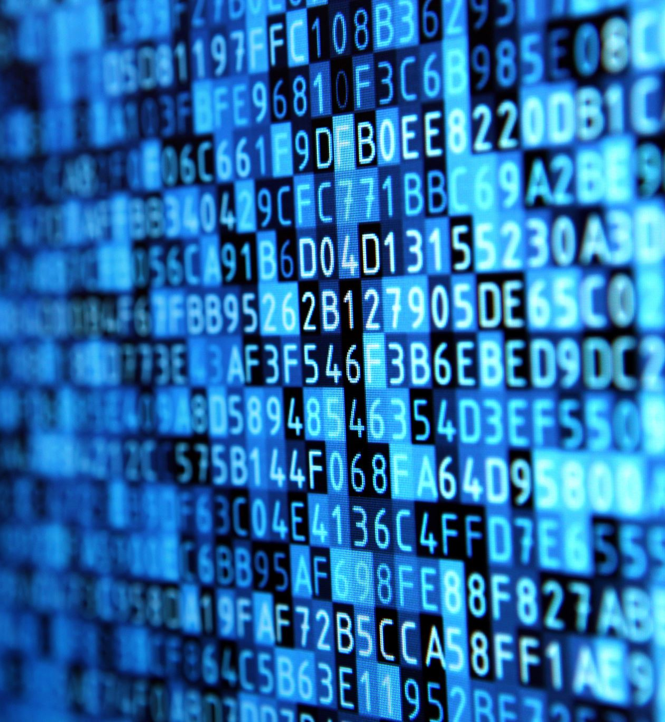
Computers and Data
With computers, smartphones, and other devices, one can listen to music, watch videos, play games, and more. The music, videos, games, and other information are the computer’s data.
Data Representation refers to the form in which data is stored, processed, and transmitted.
Computers and other devices store data in digital (data expressed in Binary) formats that can be handled by electronic circuitry.

Slide 6
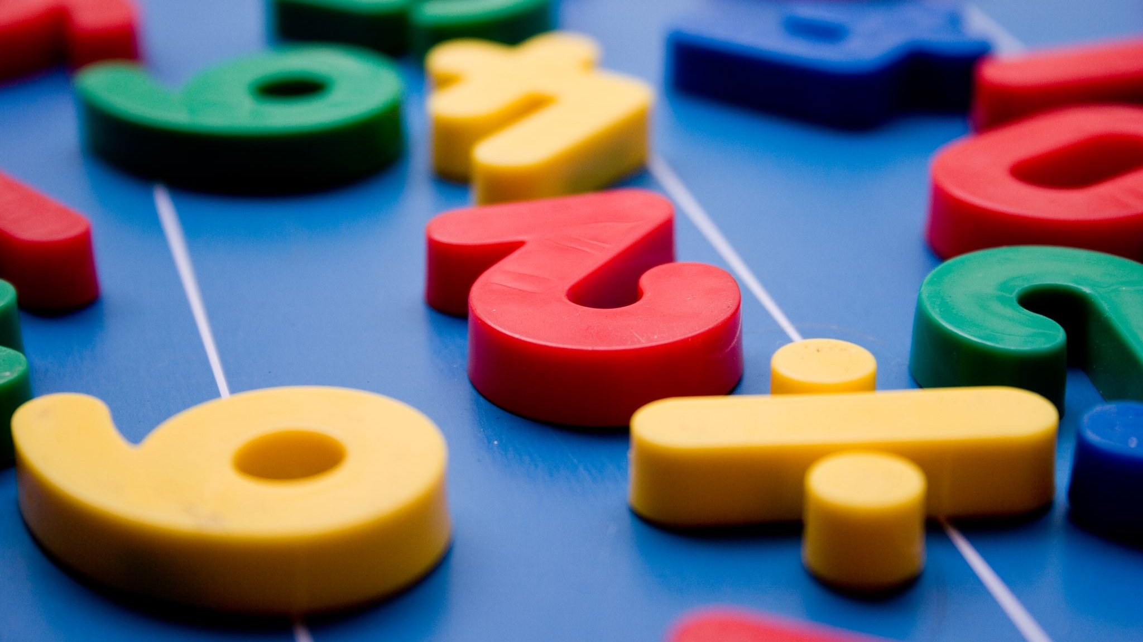
Number Systems

Slide 7
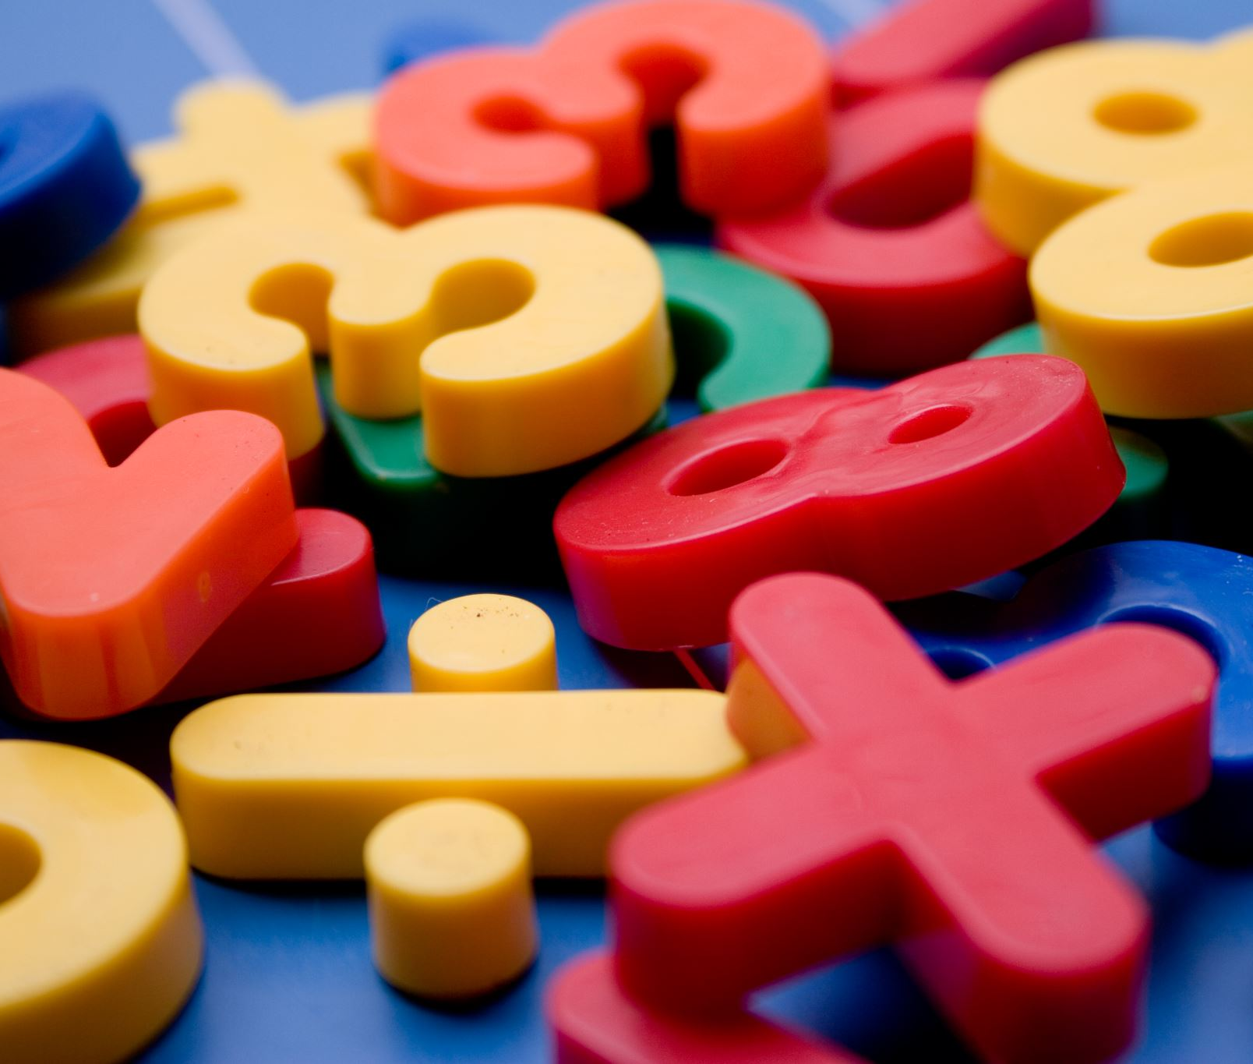

Decimal Numbers
Think about the numbers, you learned at school while growing up.
They had 10 digits: 0, 1, 2, 3, 4, 5, 6, 7, 8, 9
The number 1,248 is
$$1,000 + 200 + 40 + 8$$
We can change the representation to:
$$(1 ∗ 1,000) + (2 ∗ 100) + (4 ∗ 10) + (8 ∗ 1)$$
We can change it even further to:
$$\left(1 ∗{10}^{3}\right)+\left(2 ∗{10}^{2}\right)+\left(4 ∗{10}^{1}\right)+\left(8∗{10}^{0}\right)$$

Slide 8
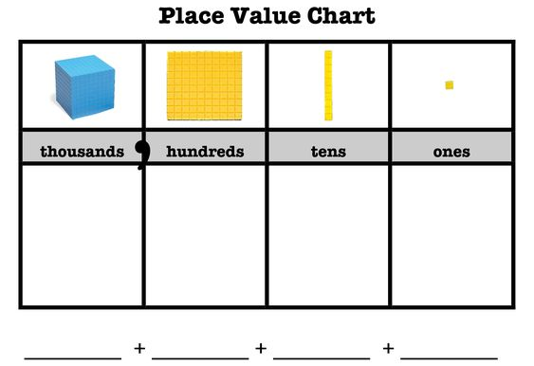
Decimal Numbers (cont.)

Slide 9
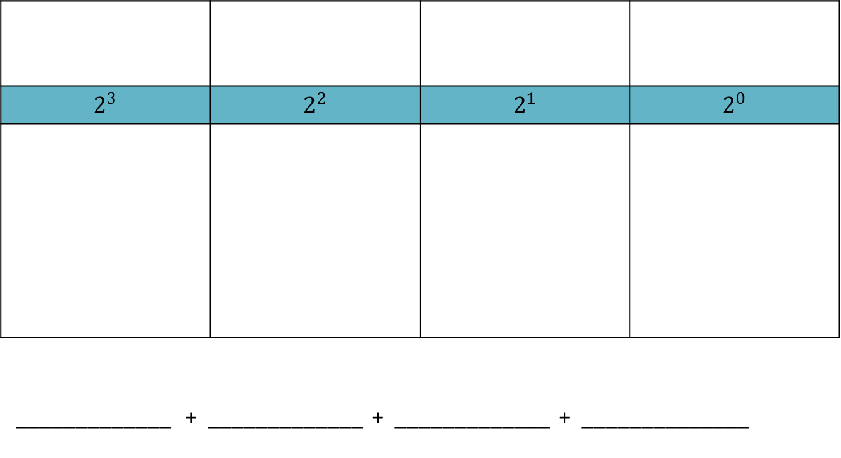
Binary
Digits: 0, 1
Base 2
Binary digit → bit

Slide 10
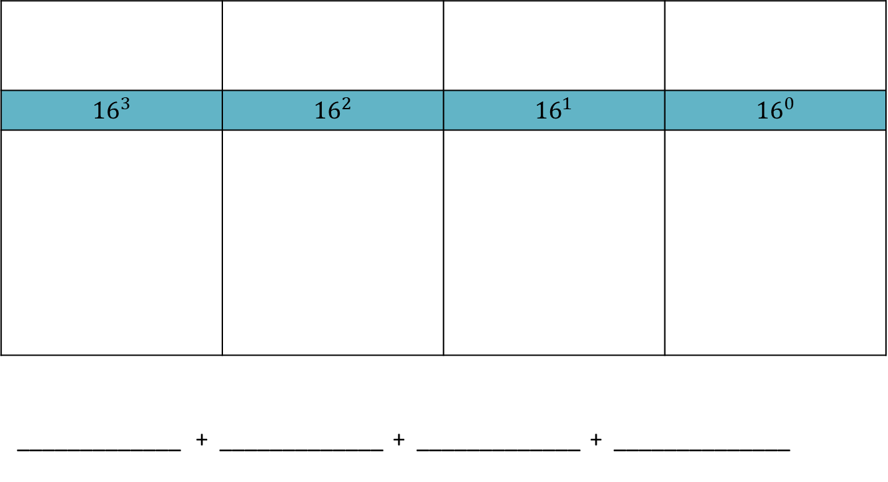
Hexadecimal
Digits: 0, 1, 2, 3, 4, 5, 6, 7, 8, 9, A, B, C, D, E, F
Base 16

Slide 11
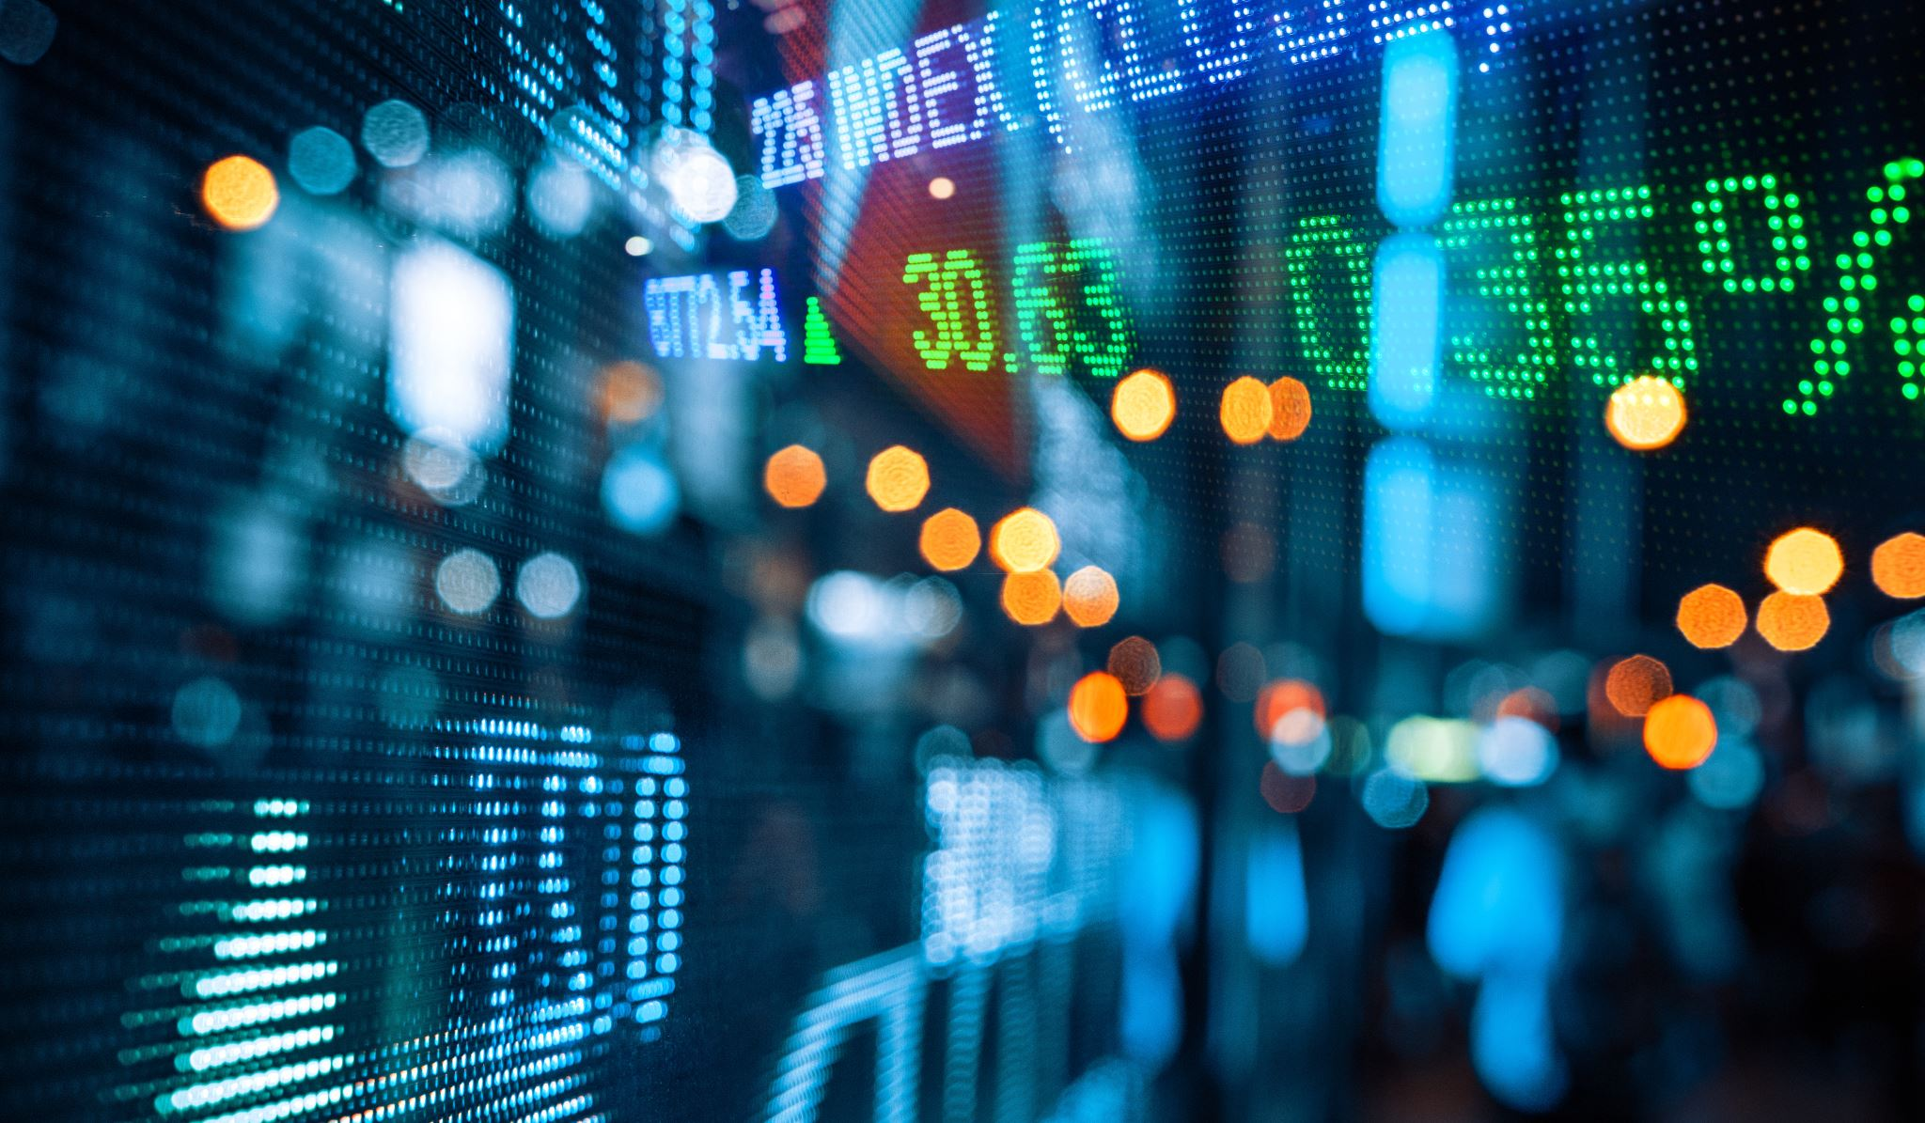
Conversions

Slide 12
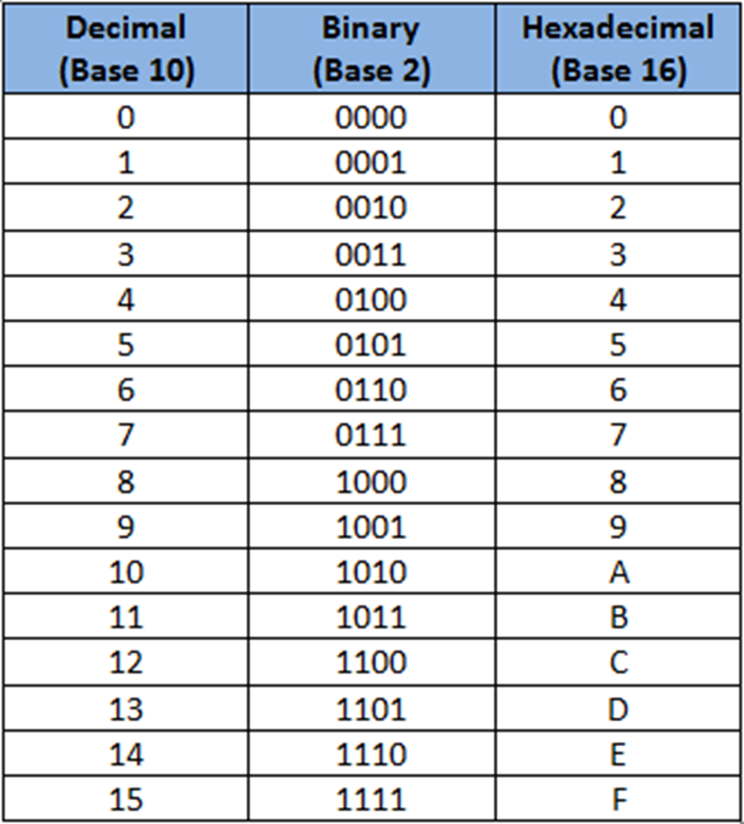

Slide 13
Converting From Decimal
Step 1.
Divide the value by the desired base number (B) and record the remainder.
Step 2.
As long as the quotient obtained is not zero, continue to divide the newest quotient by B and record the remainder.
Step 3.
Now that a quotient of zero has been obtained, the new number system representation of the original value consists of the remainders listed from right to left in the order they were recorded.

Slide 14
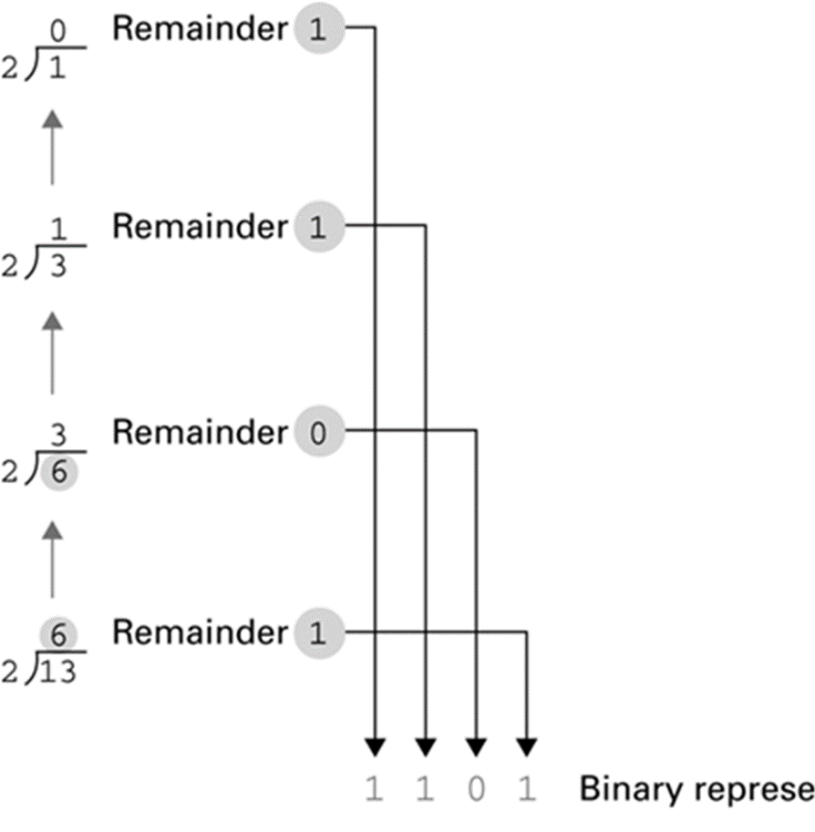
Example 1-1
Start here →

Slide 15
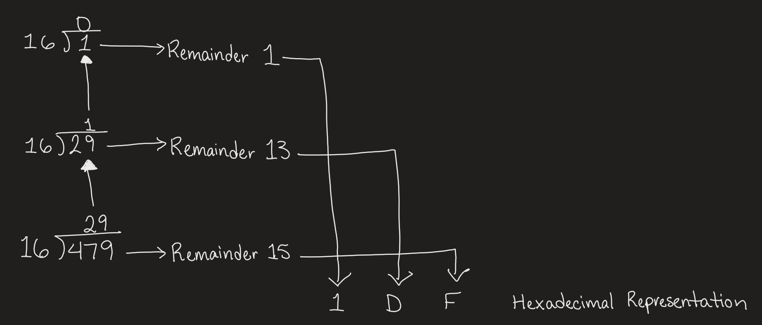
Example 1-2
Start here →

Slide 16
Converting To Decimal
Step 1.
Multiply the digit value to quantity it represents ($B^{n}$) and record the value. (Recommended to start from right end.)
Multiply the digit value to quantity it represents (𝐵^𝑛) and record the value. (Recommended to start from right end.)
Step 2.
Repeat step 1 until no digits in the number given are left.
Step 3.
Add all the recorded values together to obtain the equivalent decimal value.

Slide 17
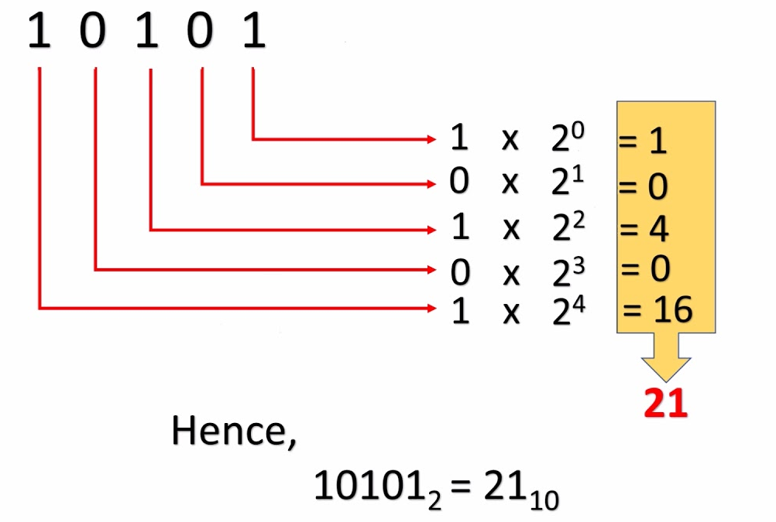
Example 2-1

Slide 18
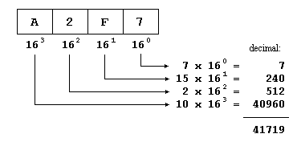
Example 2-2

Slide 19
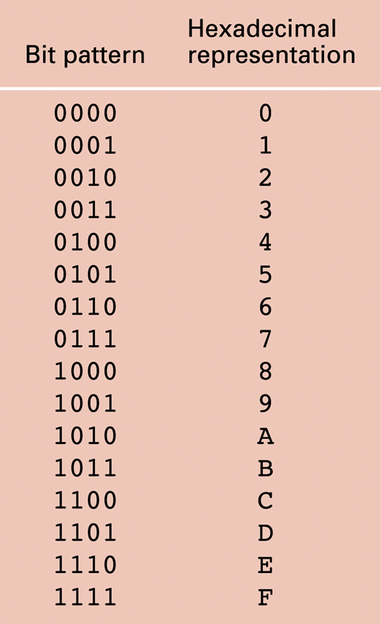
Converting From Binary To Hexadecimal
Step 1. Mark groups of four bits (starting at the right end)
Step 2. Convert each group of bits into hex digits.

Slide 20
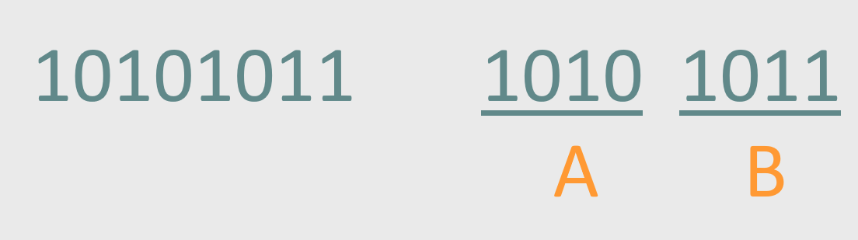
Example 3

Slide 21
Converting From Hexadecimal To Binary
Step 1. Convert each hex digit into binary from left to right

Slide 22
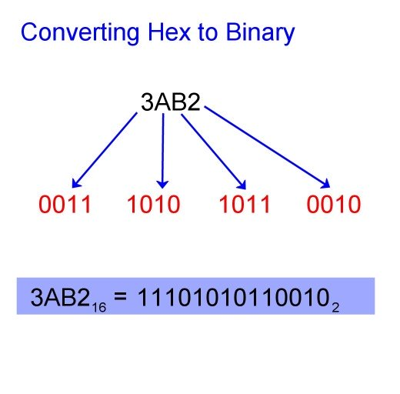
Example 4

Slide 23

Computers and Data

Slide 24

Why Binary?
Computers operate with voltage through what amounts to microscopic switches that are either “on” (1) or “off” (0).
Low Voltage = 0
Hight Voltage = 1

Slide 25
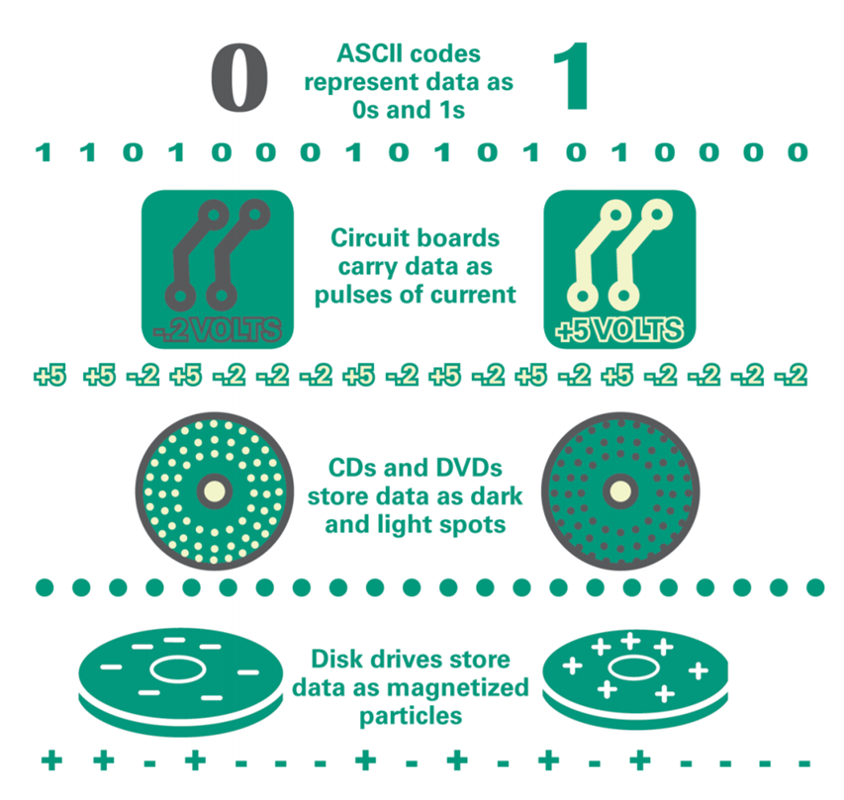

Slide 26

Bits and Bytes
Terminology related to bits and bytes is extensively used to describe storage capacity and network access speed.
Bits → binary digit
Byte → group of eight bits (abbreviated as an uppercase B)
Have you ever heard phrases like “megabytes”, “terabytes”, or something similar?

Slide 27
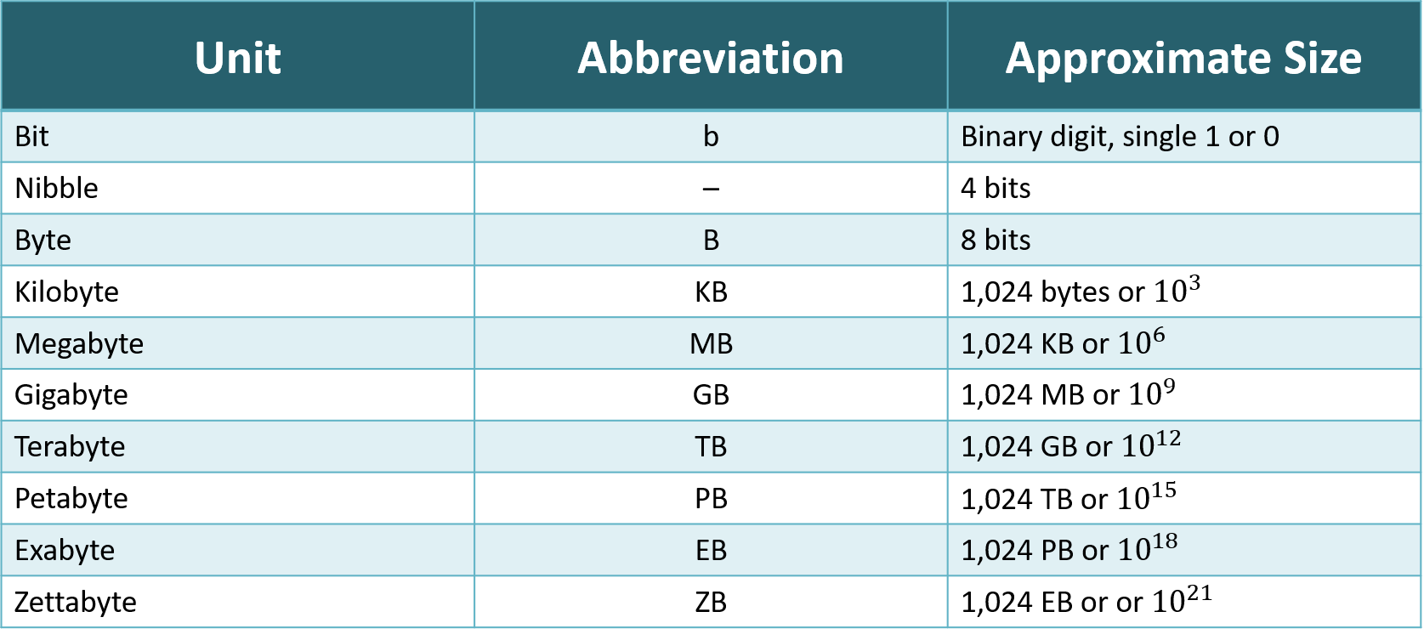

Slide 28
Representing Numbers

Slide 29
Representing Numeric Values
Using the number system (binary, hexadecimal), whole numbers (0, 1, 2,…) can be represented
What about integers and floating-point (real) numbers?
Modify binary system to represent these values as well

Slide 30
Representing Negative Values
Signed-Magnitude (SM) Notation
1’s Complement
2’s Complement

Slide 31
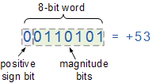
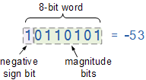
Sign-Magnitude (SM) Notation
One bit of the binary number is used to determine the sign as positive (0) or negative (1). The rest of the binary digits are used to represent the magnitude, or value, of the binary number in the usual way.
What is the problem with SM Notation?
There are two representations for 0, a positive and negative representation.

Slide 32
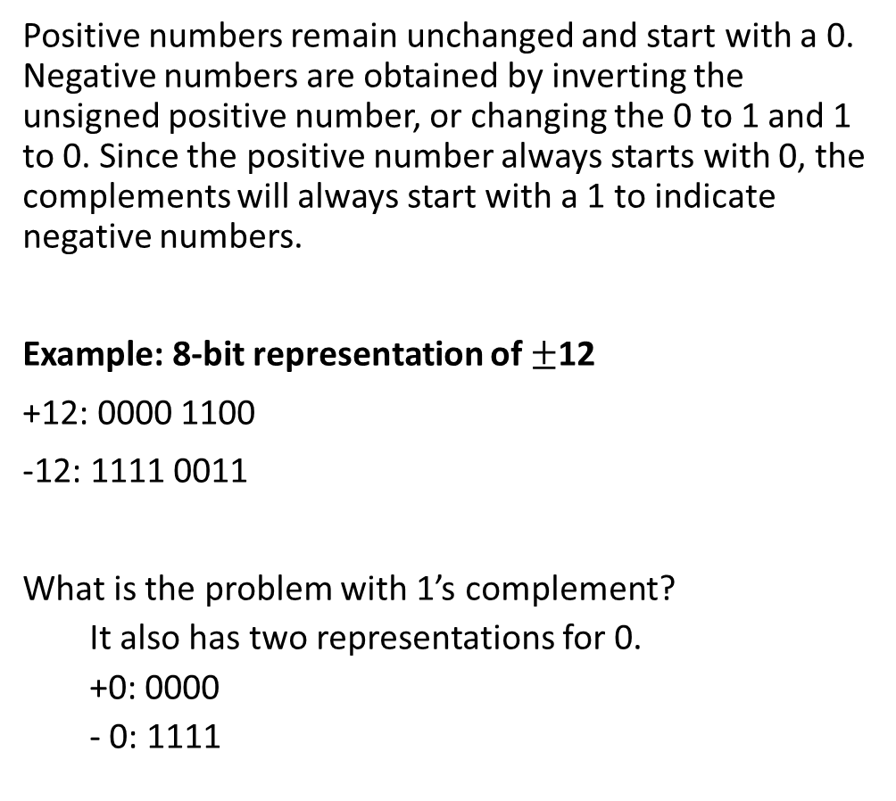
1’s Complement
Positive numbers remain unchanged and start with a 0. Negative numbers are obtained by inverting the unsigned positive number, or changing the 0 to 1 and 1 to 0. Since the positive number always starts with 0, the complements will always start with a 1 to indicate negative numbers.
Example: 8-bit representation of $±$12
+12: 0000 1100
-12: 1111 0011
What is the problem with 1’s complement?
It also has two representations for 0.
+0: 0000
- 0: 1111

Slide 33
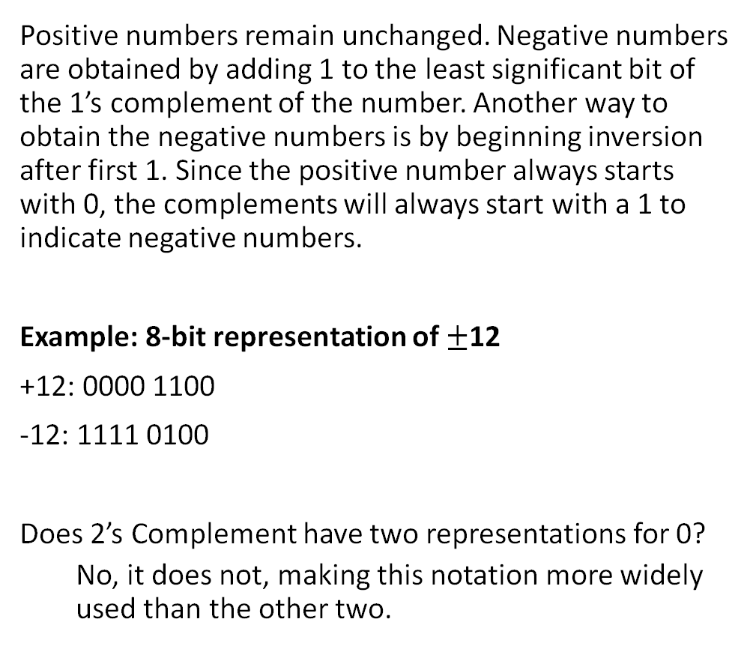
2’s Complement
Positive numbers remain unchanged. Negative numbers are obtained by adding 1 to the least significant bit of the 1’s complement of the number. Another way to obtain the negative numbers is by beginning inversion after first 1. Since the positive number always starts with 0, the complements will always start with a 1 to indicate negative numbers.
Example: 8-bit representation of $±$12
+12: 0000 1100
-12: 1111 0100
Does 2’s Complement have two representations for 0?
No, it does not, making this notation more widely used than the other two.

Slide 34
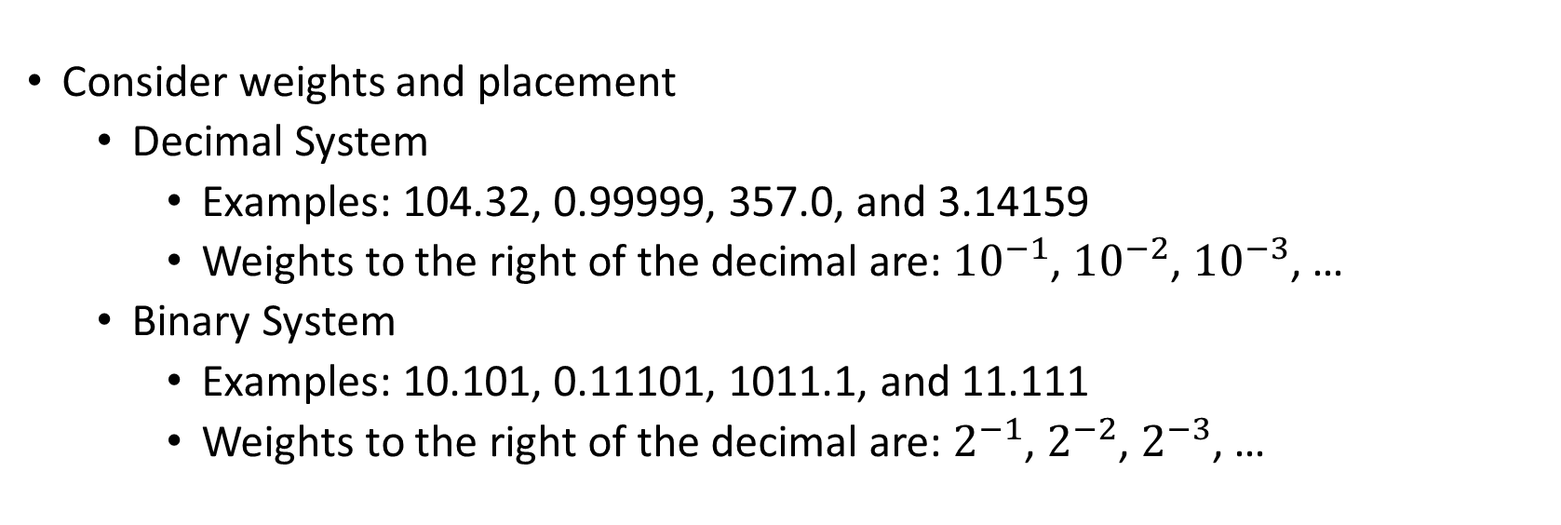
Representing Real Numbers
Consider weights and placement
Decimal System
Examples: 104.32, 0.99999, 357.0, and 3.14159
Weights to the right of the decimal are: ${10}^{−1}$, ${10}^{−2}$, ${10}^{−3}$, …
Binary System
Examples: 10.101, 0.11101, 1011.1, and 11.111
Weights to the right of the decimal are: $2^{−1}$, $2^{−2}$, $2^{−3}$, …

Slide 35
Converting To Decimal
Step 1.
Multiply the digit value to quantity it represents ($B^{n}$) and record the value. (Recommended to start from right end.)
Multiply the digit value to quantity it represents (𝐵^𝑛) and record the value. (Recommended to start from right end.)
Step 2.
Repeat step 1 until no digits in the number given are left.
Step 3.
Add all the recorded values together to obtain the equivalent decimal value.

Slide 36
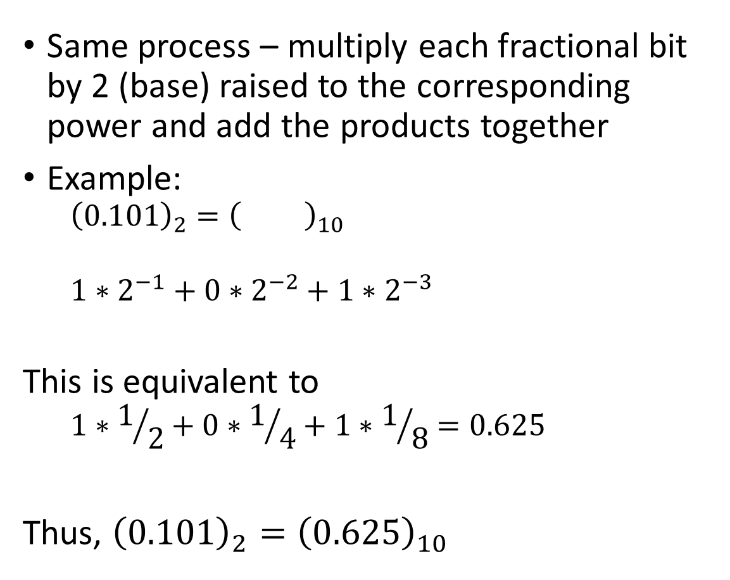
Converting Binary Fractions to Decimal Fractions
Same process – multiply each fractional bit by 2 (base) raised to the corresponding power and add the products together
Example:
$${\left(0.101\right)}_{2}={\left( \right)}_{10}$$
$$1∗2^{−1}+0∗2^{−2}+1∗2^{−3}$$
This is equivalent to
$$1∗1/2+0∗1/4+1∗1/8=0.625$$
Thus, ${\left(0.101\right)}_{2}={\left(0.625\right)}_{10}$

Slide 37
Storing Real Numbers
Sign: 0 to indicate positive, 1 to indicate negative
Mantissa: the bits that result from normalizing the number (the radix point is moved to the left of the leftmost 1 in the number)
Exponent: indicates the number of positions the radix point needs to be moved to the right (if the exponent is positive) or to the left (if the exponent is negative) to go back to its original location
Sign Exponent Mantissa

Slide 38
Storing Real Numbers
Example: (2.625)₁₀ = (10.101)₂
Normalized mantissa = .10101 This digit is lost
Exponent = 010 (+2 in base 10)
1
What if there isn’t enough room for some part of the representation (notably the mantissa)?
Truncation error, aka floating-point error.
0 | 0 | 1 | 0 | 1 | 0 | 1 | 0
Sign Exponent Mantissa

Slide 39
Real Numbers in Programming
Value | Stored as
Float | sign bit, 8-bit exponent, 23-bit mantissa
Double | sign bit, 11-bit exponent, 52-bit mantissa
Notes:
Microsoft Visual C++ is consistent with the IEEE numeric standards: it stores real numbers according to the table shown.

Slide 40

Representing Text

Slide 41
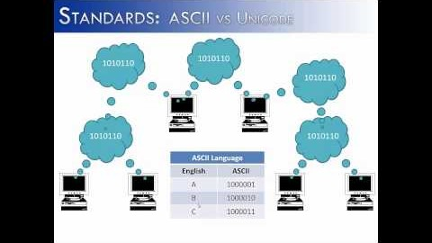

Slide 42
ASCII | Unicode | Extended ASCII
7 bits per character | 16, 24, or 32 bits per character | 8 bits per character
128 different characters | Between 65,536 – 4,294,967,296 characters depending on the system ASCII | 256 different characters
All English letters, numbers, and symbols | Contains all major languages, symbols, hieroglyphics, etc.

Slide 43
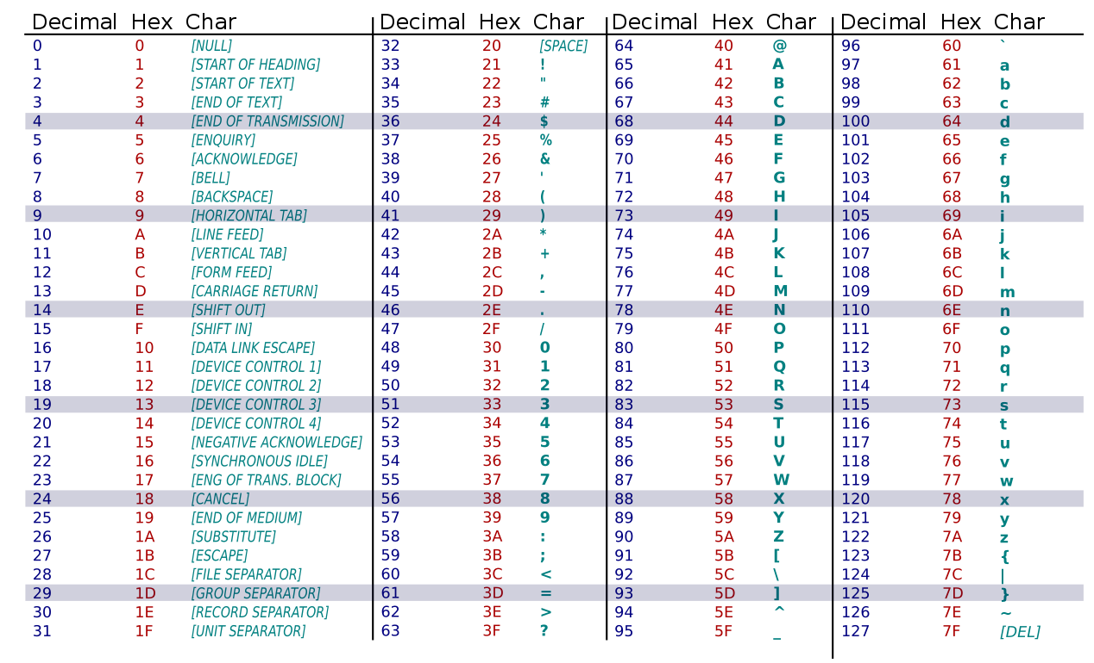
ASCII Code

Slide 44

ASCII Applications
Used for numerals
Social Security numbers
Phone numbers
Plain, unformatted text (ASCII text) stored in text file (.txt)
Apple: “Plain Text”
Windows: “Text Document”

Slide 45

Formatted Text Files
To create documents with styles and formats, formatting codes must be embedded in the text.
Microsoft Word (DOCX)
Apple Pages (PAGES)
Adobe Acrobat (PDF)
Etc.

Slide 46
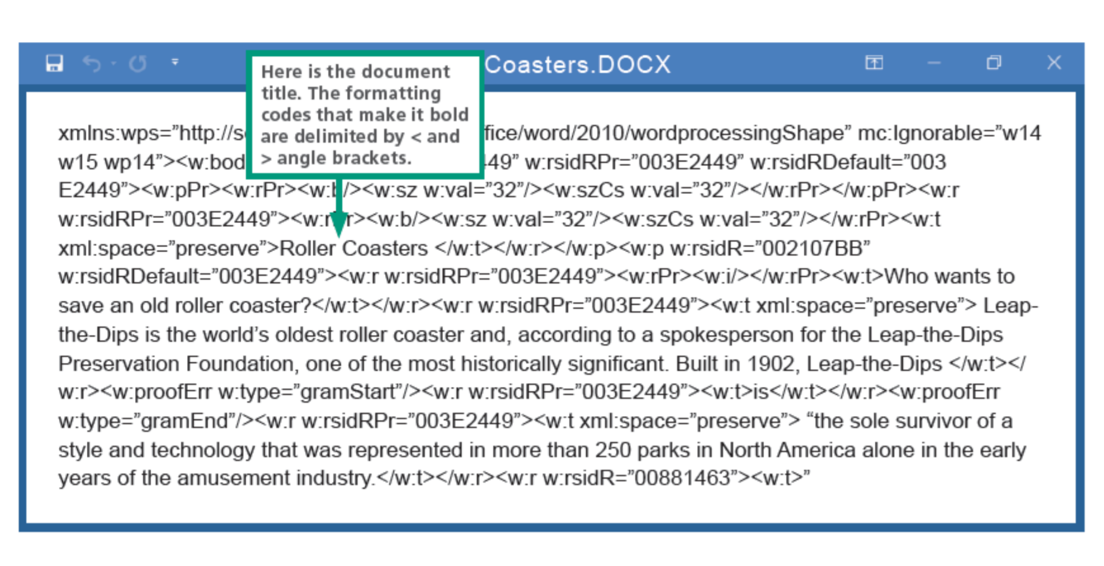

Slide 47

Representing Images and Graphics

Slide 48
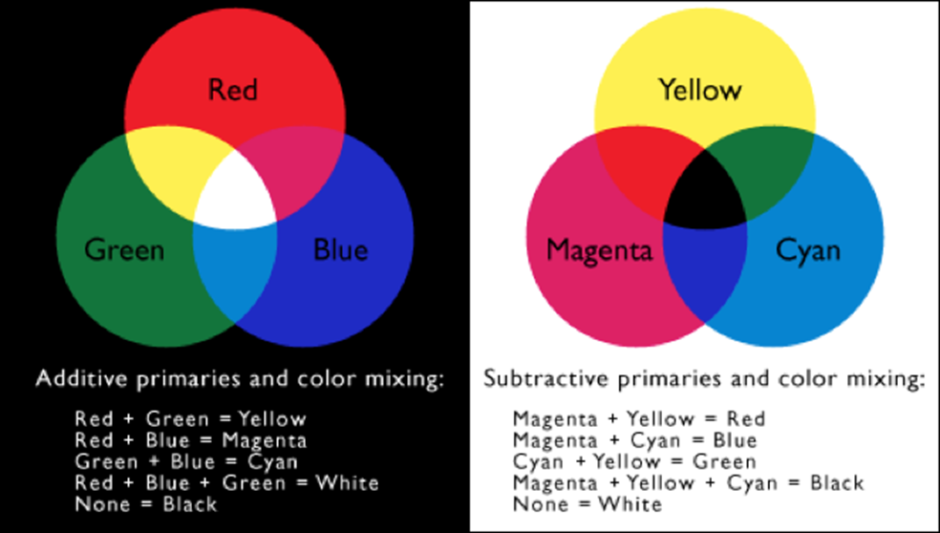
Color
Color is expressed as a combination of three colors of light
Each color value is represented as one byte, so each color value ranges from 0-255
Two Types:
CMY (cyan-magenta-yellow) → Printers
RGB (red-green-blue) → Screen
Notes:
https://csfieldguide.org.nz/en/chapters/data-representation/images-and-colours/

Slide 49

Digitized Images and Graphics
Digitizing a picture – Representing it as a collection of individual dots called pixels
Resolution – The number of pixels used to represent a picture
Raster Graphics – Storage of data on a pixel-by-pixel basis
Bitmap (BMP) → Contains the pixel color values of the images from left to right and from top to bottom
GIF → Each image is made up of only 256 colors
JPEG → Averages color hues over short distances
PNG → Like GIF but achieves greater compression with wider range of color depths
Notes:
https://csfieldguide.org.nz/en/interactives/pixel-viewer/

Slide 50
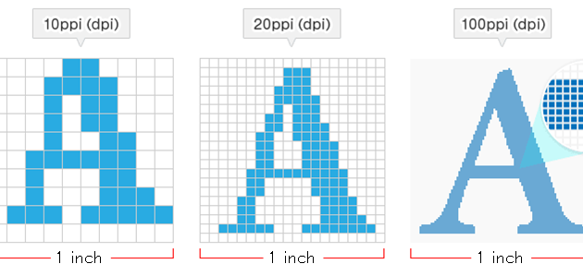
Notes:
“dpi” (dot per inch) or “ppi” (pixels per inch)

Slide 51
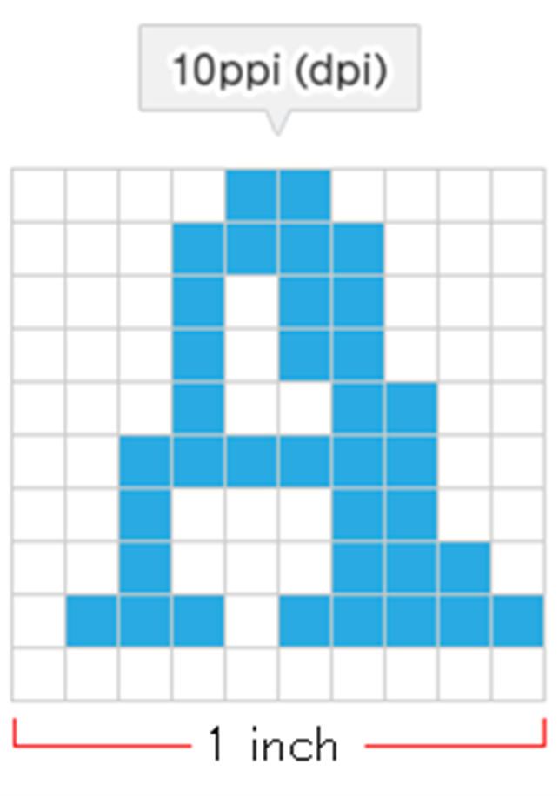
Storage
Image Specifications:
Resolution: 10ppi (10p x 10p)
RGB: 3 bytes
How many bytes would be needed to store this image?
10p x 10p = 100 pixels
Each pixel has 3 bytes → 300 bytes

Slide 52
Vector Graphics
A format that describes an image in terms of lines and geometric shapes
A series of commands that describe a line’s direction, thickness, and color
File sizes tend to be smaller because not every pixel is described
Good – resized mathematically and changes can be calculated dynamically as needed
Bad – not good for representing real-world images

Slide 53

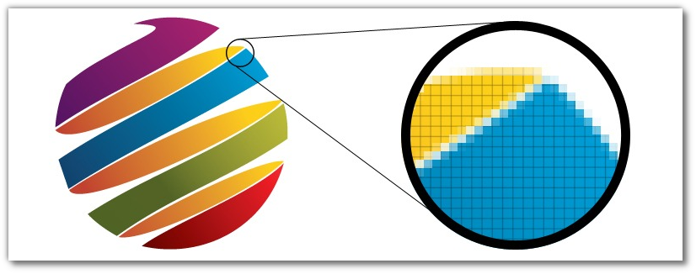
Raster vs Vector Graphics

Slide 54

Representing Sound

Slide 55
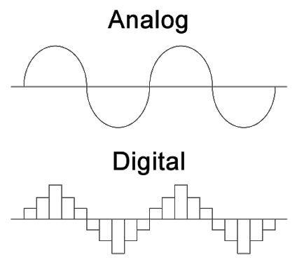
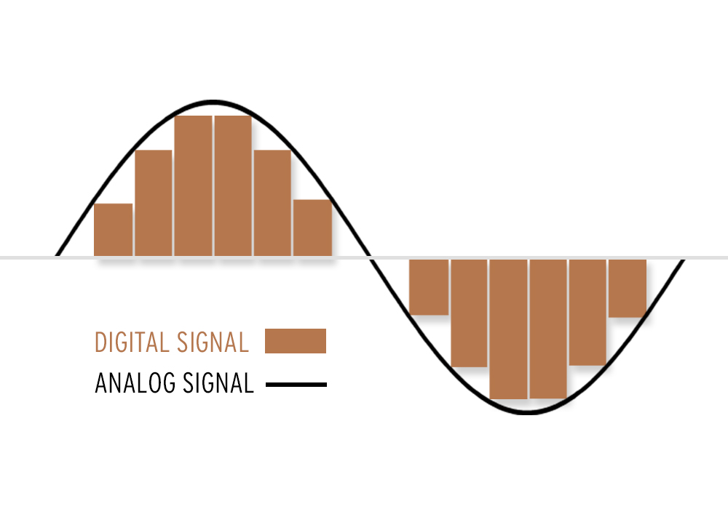
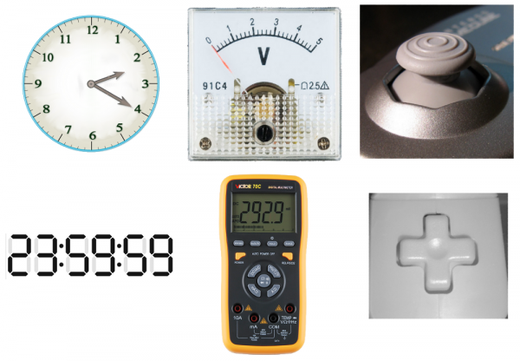
Analog vs Digital
Analog
Infinite
Real-world
Digital
Finite (discrete)

Slide 56
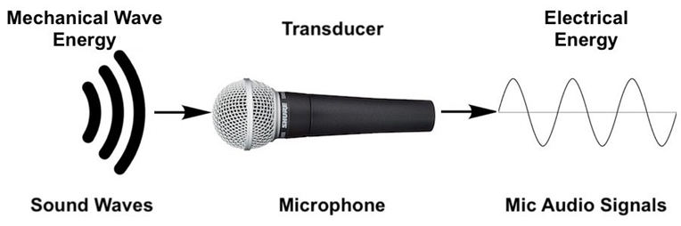
Sound
We perceive sound when a series of air compressions vibrate a membrane in our ear, which sends signals to our brain. (Analog)
How do computers perceive sound?
Example: A microphone converts the sound pressure and vibrations into an electrical signal.

Slide 57
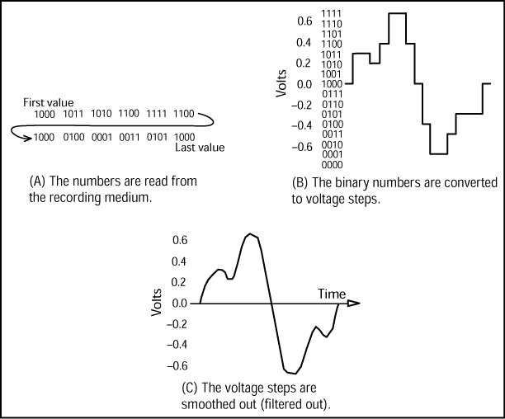
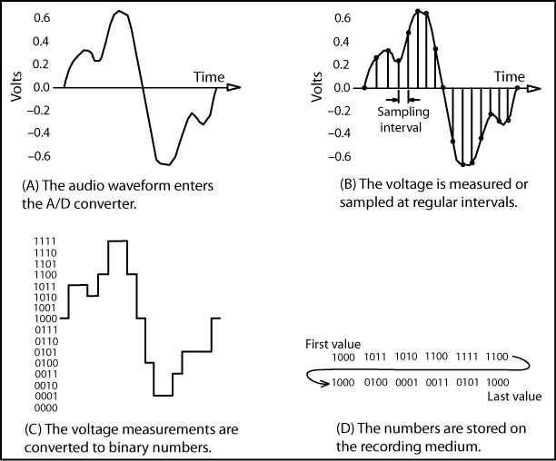
Analog ↔ Digital
Analog-to-Digital Convertor (ADC)
Digitize the signal by sampling
Periodically measure the voltage
Record the numeric value
Digital-to-Analog Convertor (DAC)
Convert back to voltage

Slide 58

Sampling
Process of measuring the sound level (as voltage from microphone) at set intervals of time (sample interval) and storing the values as binary numbers.
Sample Rate: number of samples of analog sound wave taken per second (measured in Hertz [Hz])
Sample Interval: time period between each sample (reciprocal of sample rate)
Bit Rate: number of memory bits that are used to store each sound sample
A higher sample rate (lower sample period) and high bit rate gives better quality recording but larger file size.

Slide 59
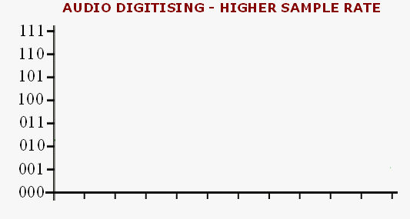
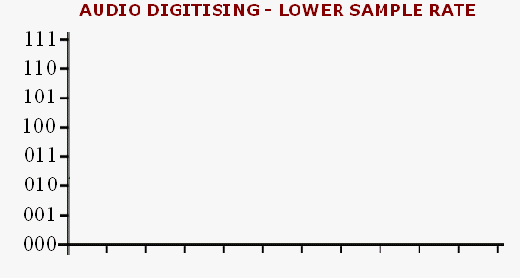



Slide 60
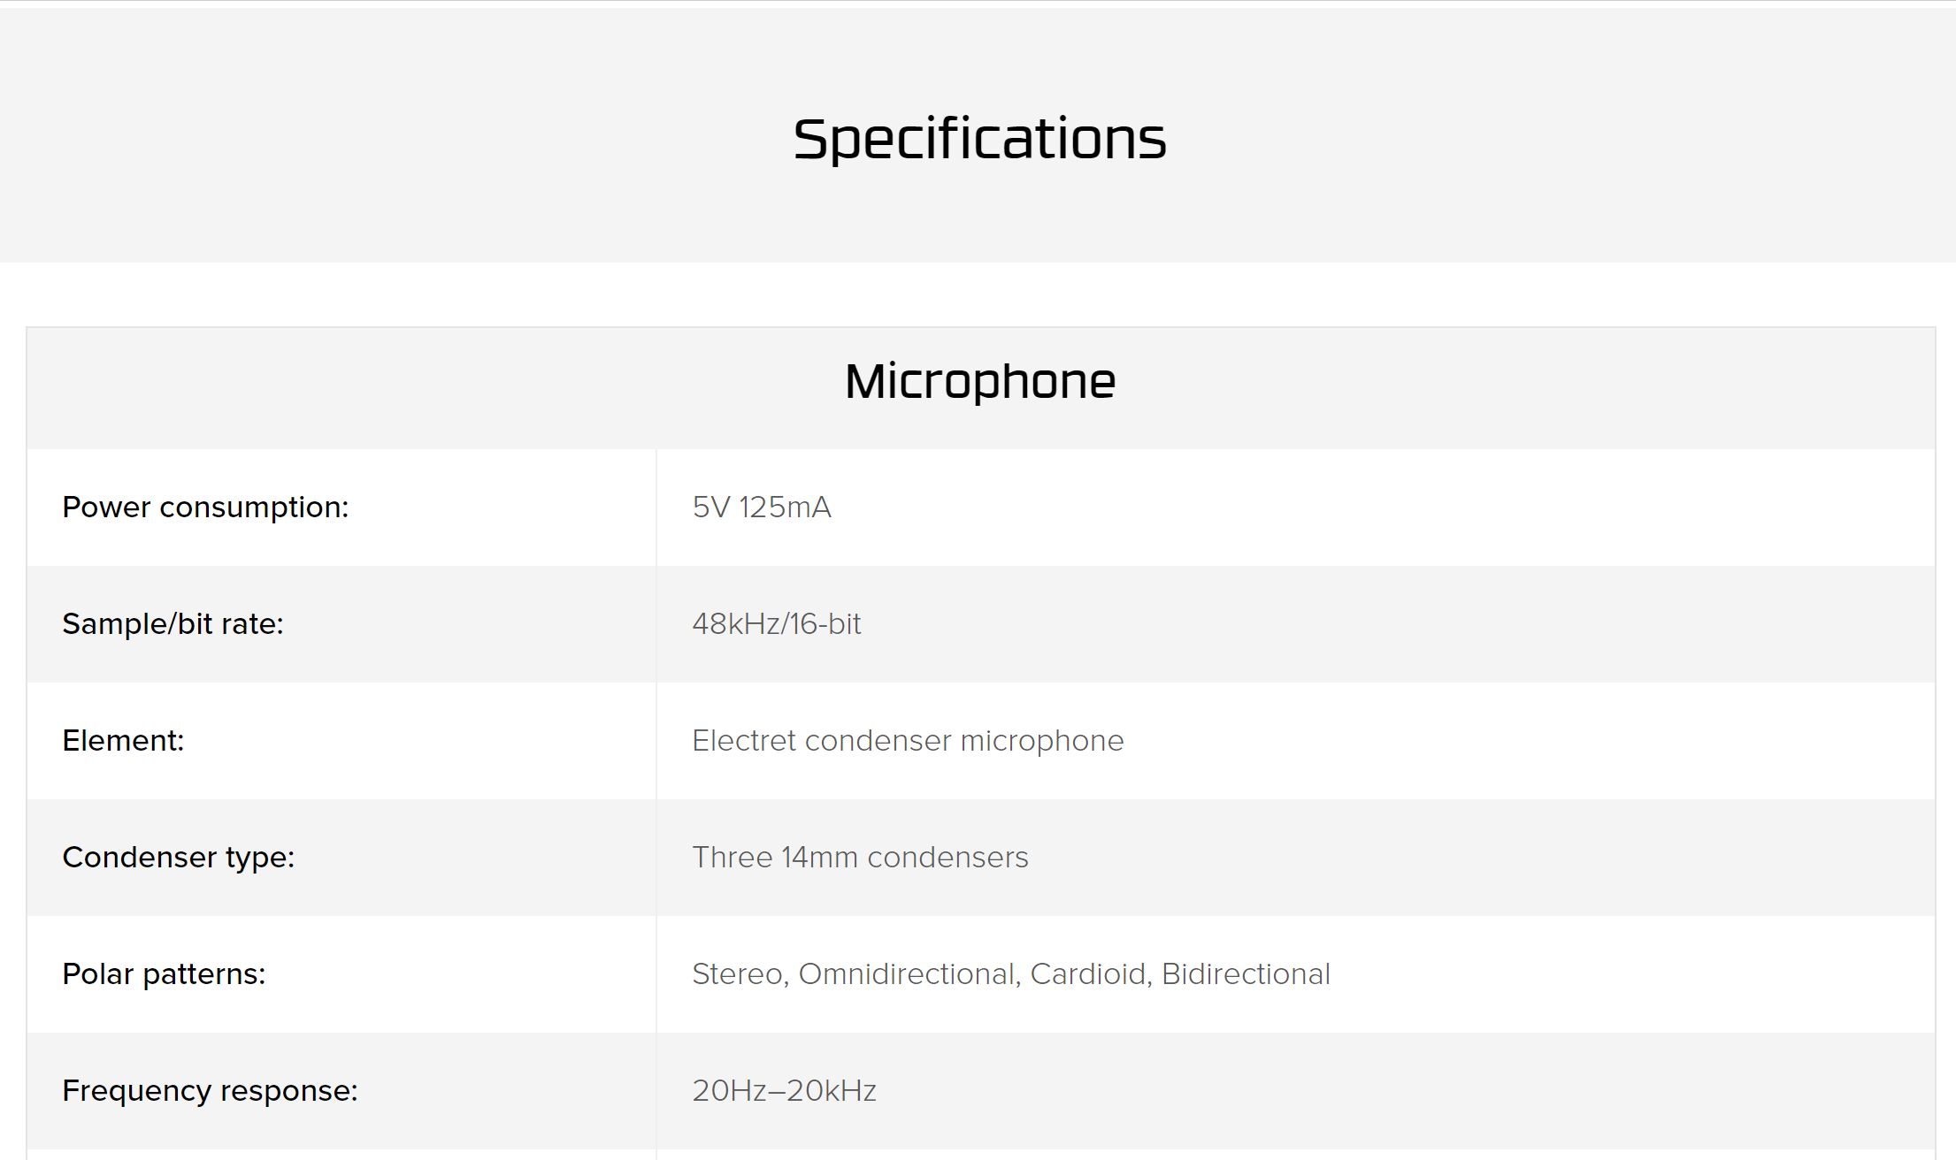
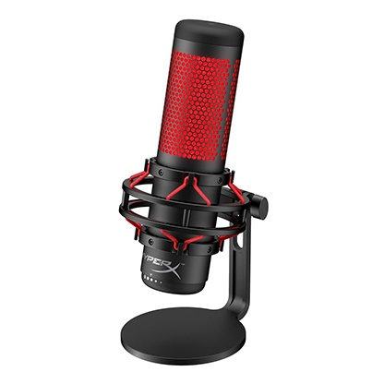
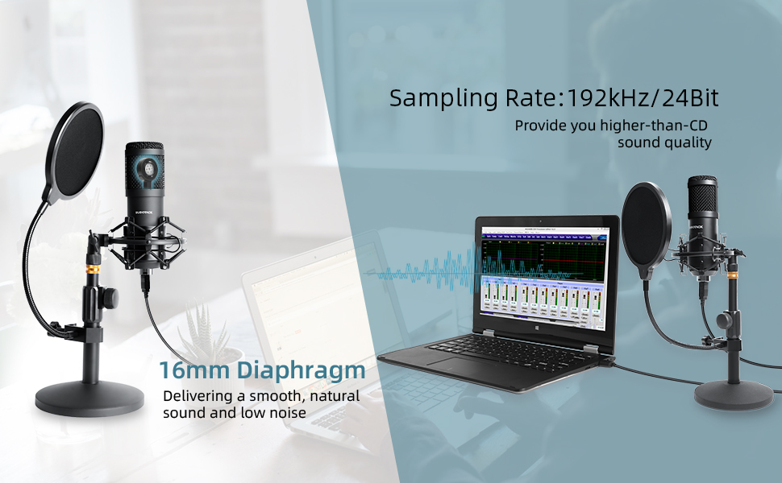
Microphones
Notes:
https://www.amazon.com/Streaming-Microphone-SUDOTACK-Professional-Condenser/dp/B07S8SSTJW/ref=asc_df_B07S8SSTJW/?tag=hyprod-20&linkCode=df0&hvadid=366281397771&hvpos=&hvnetw=g&hvrand=31352992793559686&hvpone=&hvptwo=&hvqmt=&hvdev=c&hvdvcmdl=&hvlocint=&hvlocphy=1026248&hvtargid=pla-786452269659&psc=1&tag=&ref=&adgrpid=75348279519&hvpone=&hvptwo=&hvadid=366281397771&hvpos=&hvnetw=g&hvrand=31352992793559686&hvqmt=&hvdev=c&hvdvcmdl=&hvlocint=&hvlocphy=1026248&hvtargid=pla-786452269659
https://www.hyperxgaming.com/unitedstates/us/microphone/quadcast-gaming-microphone?partnum=HX-MICQC-BK&ktc_campaign=GoogleShopping&gclid=CjwKCAjwnef6BRAgEiwAgv8mQRUQcgXZvfcncDFqCFIYr98BU9qE8PuG6jsNOKhbmp0Osevo4Wx3DxoClJUQAvD_BwE

Slide 61


Example – Audio Compact Disk (CD)
Sampling Rate: 44.1 KHz or 44,100 samples per second
Sample Interval: 0.024 Milliseconds
Bit Rate: 16 bits (65,536 different levels of sound)

Slide 62

Representing Video

Slide 63
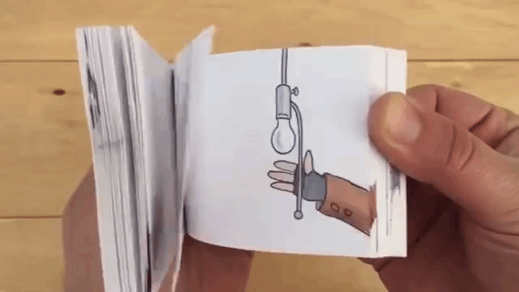
What Is A Video?
Basically a series of pictures being “flipped” through with audio
The same/similar concepts for image and audio representation apply to video

Slide 64
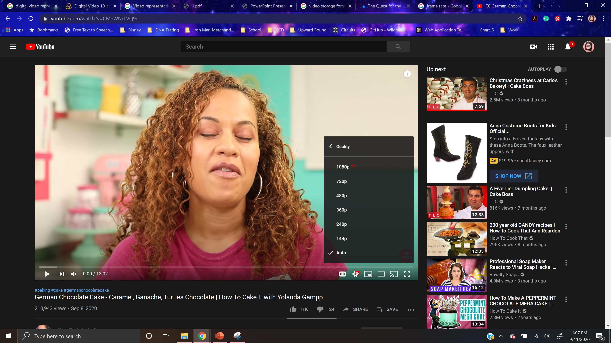
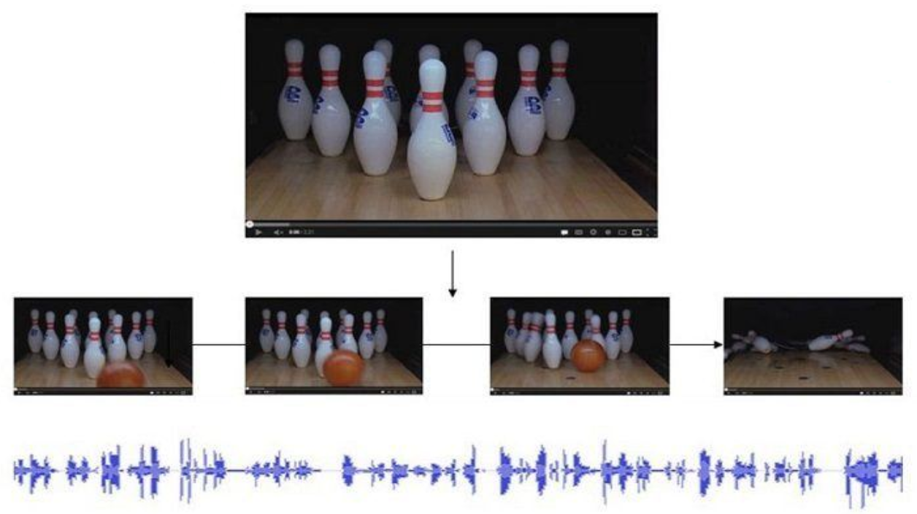
Digital Video
Made up of individual frames (images), each one representing a time slice of the scene with audio stored as a separate stream
Frame Rate: frequency at which frames are displayed
Video Quality:
The higher the frame rate the smoother the video will appear
The higher resolution the higher the quality of the image

Slide 65
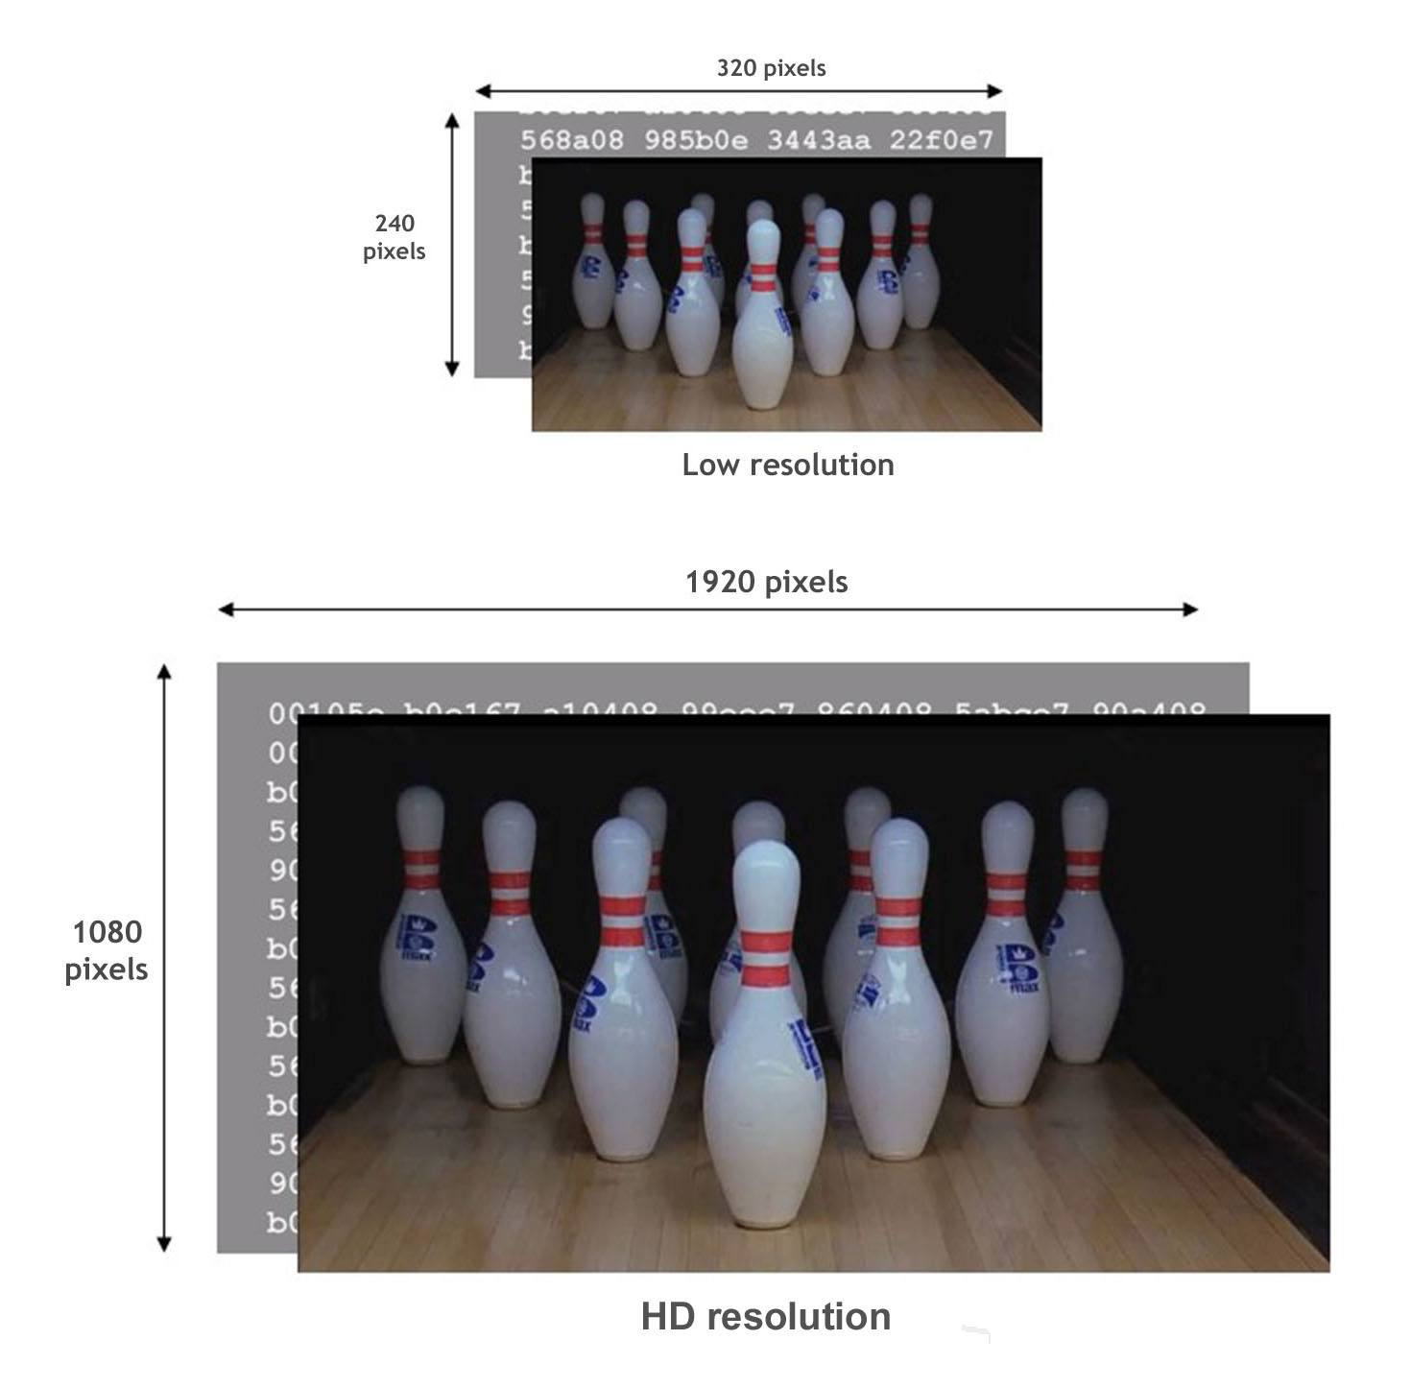
Storage - Example
Video Specifications:
Resolution: (Low Resolution) 240p x 320p
Frame Rate: 24 frames per second
How many bytes would be needed to store 1 minute of video?
240 x 320 = 76,800 pixels
Each pixel 3 bytes (RGB) → 230,400 bytes or about 200 KB
1 second of video → 5,529,600 bytes or 5 MB
1 minute of video → 331,776,000 bytes or 332 MB

Slide 66

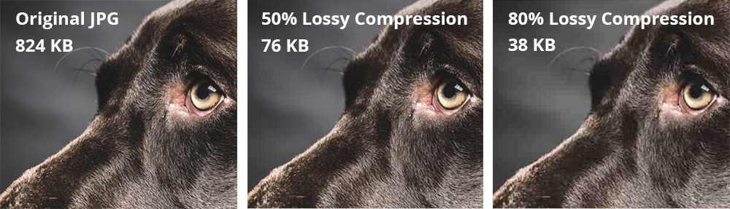
Video Codec Compressor/Decompressor
Methods used to shrink the size of a movie to allow it to be played on a computer or over a network
Almost all video codecs use lossy compressions to minimize the huge amounts of data associated with video

Slide 67

Data Compression
Lossless Compression
Provides a way to compress data and reconstitute it into its original state
Uncompressed data stays exactly the same as the original data
Lossy Compression
Throws away some of the original data during the compression process
Uncompressed data is not exactly the same as the original

Slide 68

References

Slide 69
https://home.adelphi.edu/~siegfried/cs170/170l1.pdf
https://csfieldguide.org.nz/en/chapters/data-representation/whats-the-big-picture/
https://www.digitaltechnologieshub.edu.au/teachers/topics/data-representation
https://i.pinimg.com/564x/02/0f/30/020f300815ddf2473909c8068fa933cd.jpg
https://i.ytimg.com/vi/4M6L-ubixJo/maxresdefault.jpg
https://www.cplusplus.com/doc/hex/base_hexadecimal.gif
https://usercontent2.hubstatic.com/14086459_f520.jpg
https://cdn.ttgtmedia.com/rms/onlineImages/storage-memory_capacity_chart_mobile.png
https://i.ytimg.com/vi/TpoV_iVhFt0/maxresdefault.jpg
https://sites.temple.edu/lizhe/2018/09/16/introduce-the-world-of-ascii-and-unicode/#:~:text=Ascii%20stands%20for%20American%20Standard,Unicode%20defines%202%5E21%20characters.
https://static.thenounproject.com/png/56875-200.png
https://image.flaticon.com/icons/png/512/32/32745.png

Slide 70
https://app.teamsupport.com/dc/493740/images/c698427c-c702-4463-893f-59d63ab14233.png
https://image.flaticon.com/icons/png/512/29/29072.png
https://www.logaster.com/blog/vector-and-raster-graphics/
https://learn.sparkfun.com/tutorials/analog-vs-digital/all
https://www.djtechdirect.com/blog/wp-content/uploads/2018/07/Digital-and-Analog-Wave.jpg
https://lh3.googleusercontent.com/proxy/HxkV77Agc9AniouomafNZ37L2Msc8GDzv9rS_FXReIt_N-rHcriAI954kxEHZKnZuSoxobqNZFzekwEB8CC3-o1nAd0dwPSujNuF6f_kWZUBPBYIt58AzjZFUevwa7ZtJsgjkQ0
https://mynewmicrophone.com/wp-content/uploads/2019/08/mnm_How_Do_Microphone_Transducers_Work.jpg
https://mynewmicrophone.com/are-microphones-analog-or-digital/
https://teachcomputerscience.com/sound-representation/#:~:text=How%20can%20sound%20be%20sampled,converted%20into%20a%20binary%20number.
https://www.youtube.com/watch?v=iqjzZDWoW7s
https://l2pnet.com/digital-recording-does-not-chop-your-music-11102010/

